Slide 1
Stevens Shuttle Tracker
Chintakuntla Anudeep
Hongsen Xin
Catherine Kim
David Sobiepan
Sean Vazquez
Notes:
This is our presentation on our design improvements to the current Stevens shuttle tracking mobile application.

Slide 2
Project Description
Goal
track shuttle location and estimated time to stops for each shuttle route
improve user interface design of the existing shuttle tracking application, Transloc Rider
Target Population
Stevens students, particularly those that live off campus
Target E
Easy to Learn
We will measure improvement by:
surveys of satisfaction from students and commuters at Stevens who take the shuttle
paper prototyping/mockups
Notes:
The goal of our project was to improve the user interface design of the existing shuttle tracking application called Transloc Rider. Our application should be able to help users keep track of the the shuttle location and estimated times and locations of stops for each shuttle route. We wanted to create a design that was easier to use, since the current implementation was difficult to use and understand, especially on the first use. We believed that we could make simple, but effective design changes to improve the usability of the app.
Our target population was mainly Stevens students, particularly those that live in the Hoboken area or those that take the shuttle to and from Hoboken Terminal. We felt that one of the flaws of the current application was that it catered to a large population of several different schools which complicated things like route and shuttle selection. We wanted to make our application specific to Stevens in order to cut down some of the steps in using the app.
We decided that we wanted to target the E for Easy to Learn. We believed that there was much room for improvement in the user interface design of the current app and that it is a bit confusing to use at first. We thought that we could make design changes that would help users figure out how to use the app faster. Other major problems of the application has to do with availability of the shuttle location, which is not something that we can control. Therefore, we thought it best to simply focus on making our design easy to learn.
Since Easy to Learn is something that is not very easy to evaluate quantitatively, we decided to measure our improvement mainly through interviews and surveys of satisfaction from students and commuters at Stevens. Since we were limited on time, we were aware that a full implementation of the application would be difficult. We therefore planned to have users evaluate our design through paper prototyping or paper mockups, as well as walkthroughs through our actual mockups. We decided that it would be best to receive feedback from both students who use the current application as well as those who do not. This way, we can measure how easy our design is to use by those who are not familiar with the old design, but since a large proportion of our target audience regularly uses the current implementation of the application, we can also receive feedback on how our design compares to the old one by users who currently use the Transloc app.

Slide 3
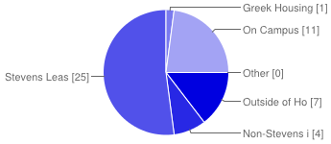
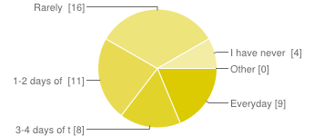
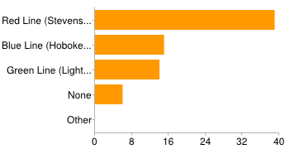
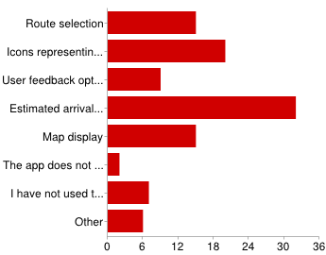
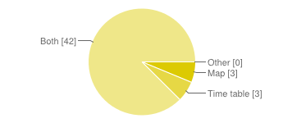
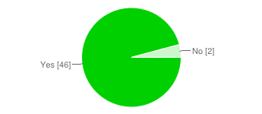
Survey
https://docs.google.com/forms/d/1X-l-cksySK-8GIzp0--r39R-ifcHYDrgMKfYc46B-oY/viewform
On average, how often do you take the Stevens shuttle during the week?
What are all the shuttle routes that you have taken?
Where do you live?
What features of the application do you think could be improved?
In the application, would you prefer a map display, a time table display, or both to keep track of the shuttle?
Do you think that it would be helpful to be able to see rider feedback in the application?
Notes:
We sent out our survey mainly through the Stevens Facebook pages and we received 48 responses. The link to our survey is listed at the top of this slide. We tried to make the survey short so that many people would fill it out, but we also tried to include questions that would give us a good idea of what to do in terms of application design. We had mainly multiple choice questions with one optional short answer question where we asked users what features they think could be included in the application to make it easier to learn to use.
We found that no users surveyed use the shuttle application for any non-Stevens routes. Therefore, we were justified in our decision to cater our application to only the Stevens shuttles. We also had a few ideas for our application that we asked users about in order to gage whether they would be good to include or not. We found that most students surveyed wanted to see rider feedback in the application, as well as a display of both a map, as well as a timetable to keep track of the shuttle. We also asked about which features users did and did not like in the Transloc application in order to narrow down what changes we should make.

Slide 4


Personas
George- Age 20
Undergraduate at Stevens that lives outside of Hoboken.
George is always on the go; though he lives at home, he spends most of his days in Hoboken.
He’ll go with his friends on the shuttle back to their housing; when the time comes to go home, though, he’ll hop on the blue line shuttle as long as there’s enough time to get to his train.
Because his train only runs once every two hours after night classes end, he desires an application that will help him quickly plan his commute home. To decide whether he’ll walk to the train station or use a shuttle, he’ll use the Transloc app.
However, George is annoyed knowing he has to switch between lines each time. He also has too look up the time tables of the different shuttle routes on the Stevens Office of Residence Life website, since the information is not provided in the app.
Jessica- Age 21
Undergraduate at Stevens that lives in Stevens Leased Housing.
She has a lot of work on her hands, as well as meetings to attend to online.
She uses the red line shuttle whenever she can to save valuable time on her commute to and from campus for class and other on campus events.
She actively uses the current Transloc application on her iPhone so she knows when to expect her shuttle.
Given that she is always running late, she would love an app that could offer an easy to see timetable to see the next shuttle’s arrival at a glance. She would gladly love a feature to see other users reports about whether the shuttle is running late, too.
Notes:
Here we have two personas that represent two different types of users of our application. We created these personas using the information we received from the surveys, as well as some industry data we collected from reviews of the Transloc Rider application in the Google Play and iTunes app store. George represents the user that has a much longer commute to and from campus and likes to use the application in order to plan his commutes in advance. He is on a tight schedule due to the times the trains run. Jessica is another type of user which represents many students that live around the Hoboken area that mainly take the shuttle to save on time or because it is convenient. These users are more flexible in terms of schedule, but they are more concerned with catching the next shuttle as quickly as possible, rather than planning a trip in advance (like George).

Slide 5
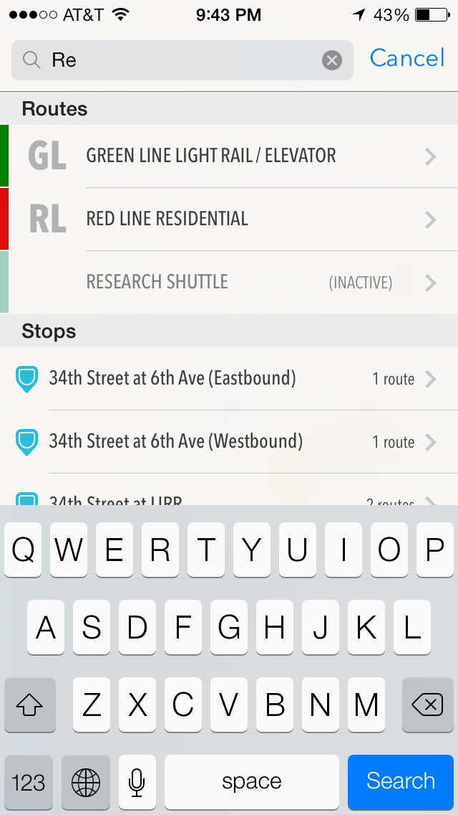
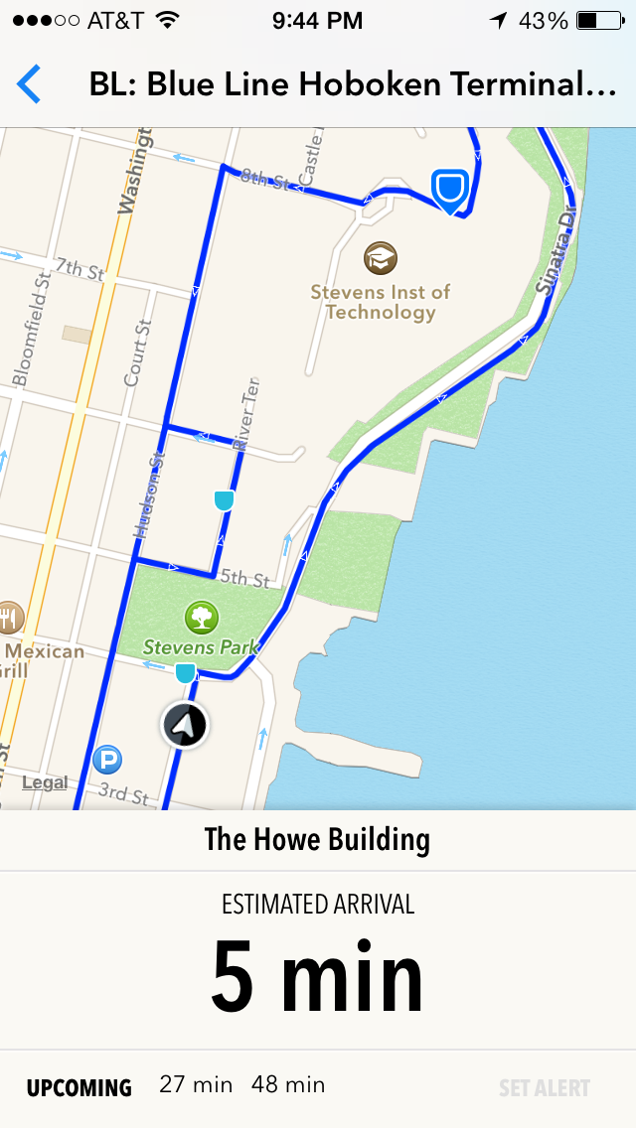
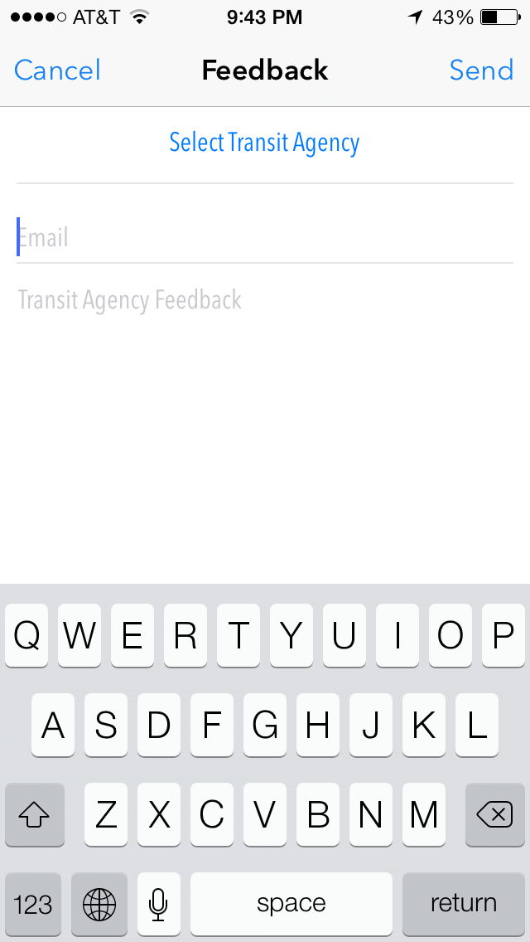
Transloc Rider App
Notes:
Here is the current user interface for the Transloc Rider Application, which is the current application that is used to track the Stevens shuttle. As you can see above, to select a shuttle route, the user must type into the search bar at the top of the screen, which brings them to the second screenshot above. You can see that the lines provided are not only the Blue, Red and Green lines that Stevens offers, but also other lines such as the Research Shuttle, which is irrelevant to our target population. In the second screenshot, The black icon represents the shuttle and the blue icons are the different stops. The darker large blue icon is the currently selected Howe Building stop. We found that the icons were a bit difficult to interpret. The last screenshot is the only feedback option on the application. In the settings, the application lets the user send an email to the transit agency, but there is no feedback that users can see from other riders.

Slide 6
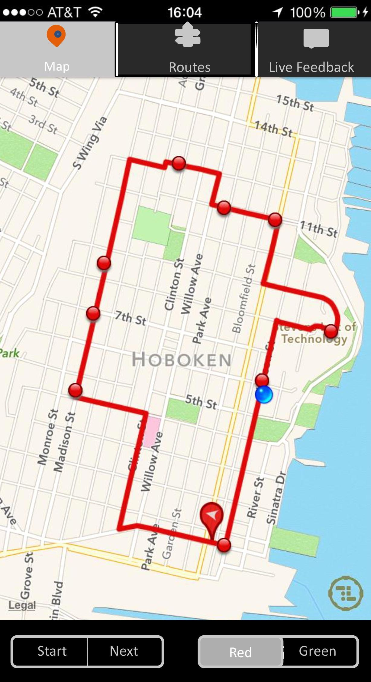
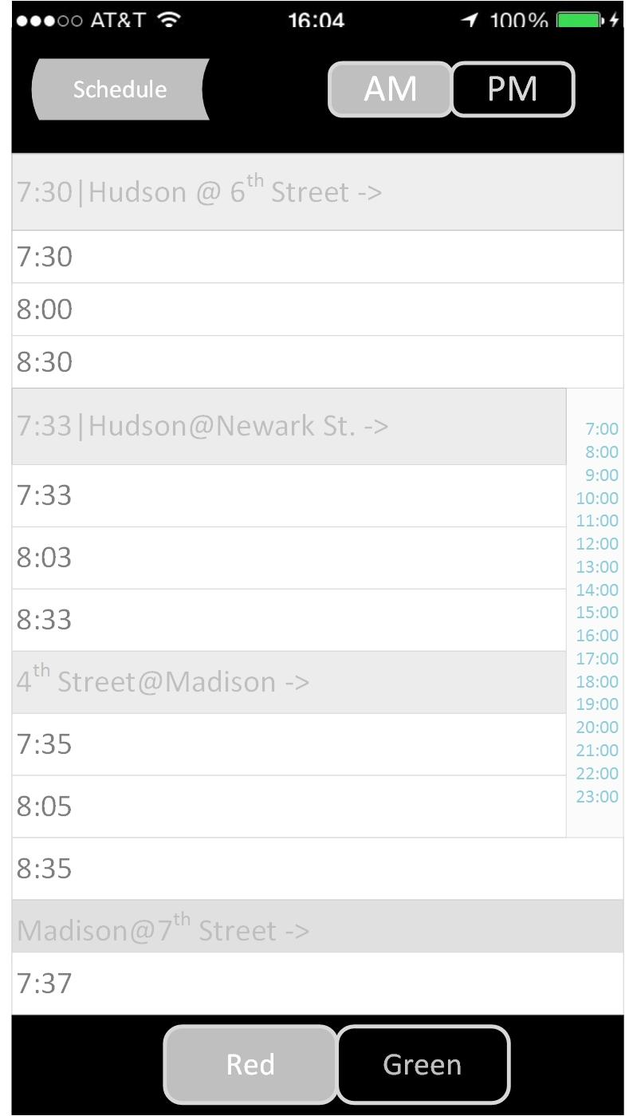
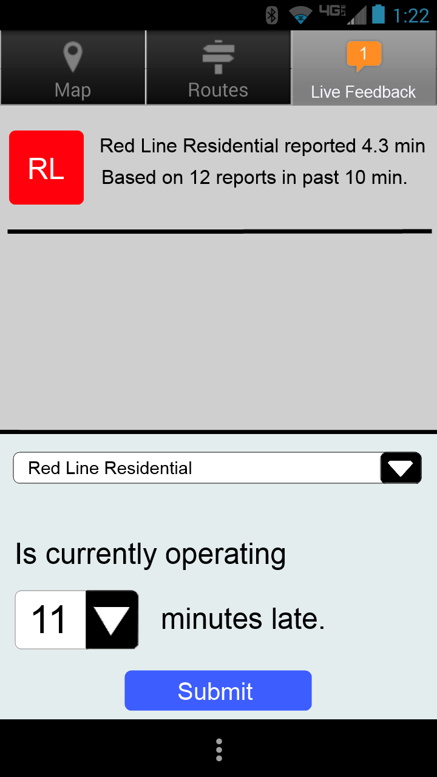
First Design
Notes:
Here are three mockups of our first design iteration. We catered to our target population of Stevens students by limiting route selection to only the Stevens shuttle lines. This way, instead of having to type in and manually search a shuttle route, the users will see the relevant ones listed clearly at the button as a button that they can select. We think that this will make route selection much simpler and easier for first time users of the application.
One of the key aspects of our design is the use of tabs to organize the different functions of the application. We split the app into three tabs, a map tab which displays a map view of the shuttle, user and stop locations, as well as estimated arrival times. It is not shown here, but when a user clicks on a shuttle stop on the map, it will bring up a box with the number of minutes that the shuttle will take to reach that particular stop. We also have a timetable time which is useful for planning trips in advance. This tab is intended to have a static view of the shuttle schedule for the entire day, rather than just the schedule for only an hour or two in advance, which is provided by the map tab. Finally, we have a feedback tab where users can provide feedback on the timing of the shuttle. We felt that this tab was especially useful and necessary since there are many days where the shuttle is unable to be tracked. Users may have to rely solely on other user feedback in order to keep track of the shuttle. We believe that these features make sense as separate tabs because the map tab is designed to be a quick and easy way to figure out where the shuttle is and how many minutes the current shuttle will take to reach a particular stop on its route, while the time table tab will be useful for users who have more time to sift through the different timing options in order to plan out their trip.User feedback can be provided when a user is already on the shuttle or after the user has gotten off the shuttle.

Slide 7
User Feedback
Positives
Rider feedback information helpful
Inclusion of timetable is a useful addition to the app
Route selection buttons are easier to use than route search feature
Issues / Improvements needed
In map tab, use of ‘Start / Next’ buttons is unclear
Font of the timetable bland and hard to read
In feedback tab, it is hard to tell how many minutes the shuttle is running late
Would be useful to display other types of feedback besides just how late the shuttle is running
Tabs missing from timetable mockup
Would like to see how estimated times to stops are displayed in map tab
Notes:
Due to time restrictions, we decided to interview/survey a few users on our initial design, but have a more detailed review. We sat down with two Stevens students who live off campus, but in Hoboken who are users of the current application. We asked them several questions about their impression of our design and how it compared to the current implementation of the application. We asked them what features they were initially confused by or what features seemed unnecessary and we also asked them what features they thought were effective. We took a more heuristic approach rather than a quantitative approach and just asked for general feedback about our design. Listed above is some of the general feedback we received.
We also sat down and sketched out some new designs on paper and asked the users their opinions on different features that we could incorporate into the designs. Some of these features you will see incorporated into our final design.

Slide 8
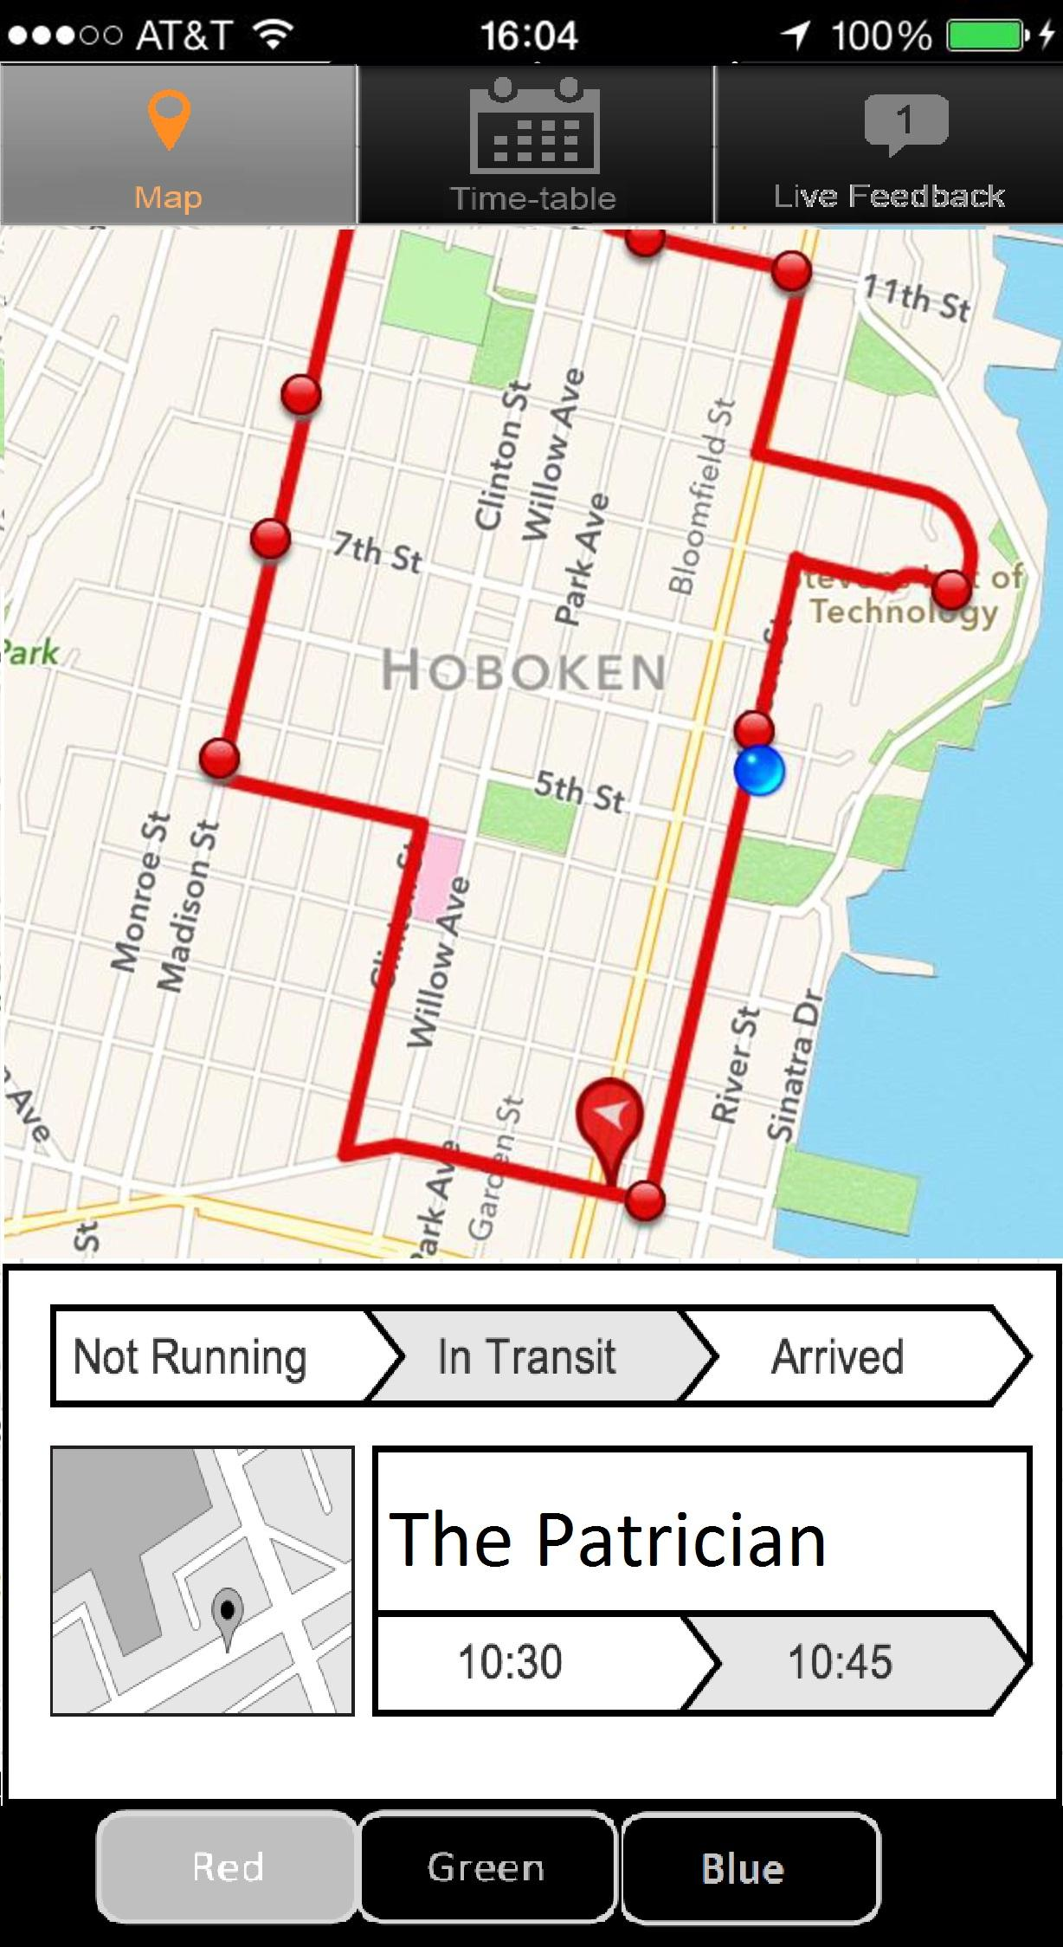
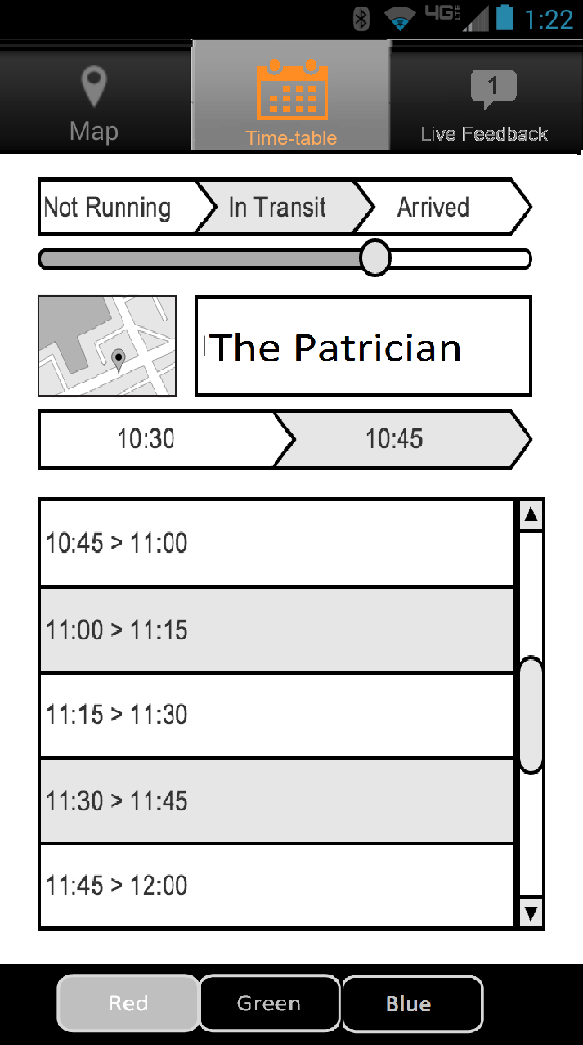
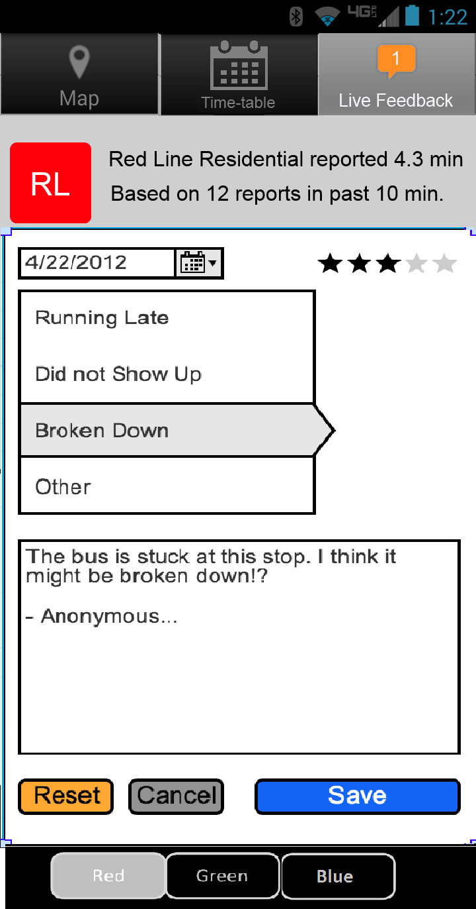
Final Design
Notes:
Map Section -
Features:
Clicking on the map shows a small informative screen for the user to learn quick info.
Clicking a different stop will bring up the estimated arrival times for that section of the shuttle’s trip.
Routes Section -
Features:
Shows current data depending on the buses travel progress.
Shows future transit options and times the shuttle will reach a certain stop.
Live Feedback Section:
Features:
Shows name of utilized Bus line and lateness reports.
Shows date of the line used, a rating for the service, specific genre of the review if wanted, and a message to comment.
Feedback from other users can be viewed in this tab in order to find information about the shuttle. Users can search by topic in order to help filter user comments.

Slide 9
Design Reviews
Simplicity Review
route selection, tabular organization, simple colors and labels
Accessibility Review
accessible to those that are color blind and deaf
accessibility of shuttle’s whereabouts by user feedback
Heuristic Evaluation
Improves upon consistency from prior version
Lack of in-app help is problematic to new users
PAR Review
simplified various features of the app
attention could be improved by having a more attractive design
Easy to Learn Improvement
simplified route selection, reverted to old map design
feedback option may be a bit confusing
Notes:
Simplicity Review
In class, one of the things we were advised to do is automate when we can in order to simplify user actions. This is what we tried to do with route selection. Instead of having the user look up routes in a search bar, we provided them as buttons at the bottom of the screen that users would select. This route would stay selected when switching tabs unless the user chooses to select a different route. We thought this would make it easier for the user since we found from our surveys that many users take the same shuttle route. In terms of the law of simplicity of organize, we tried to make a simple tri-tab design with clearly marked labels for each tab. We kept the route selection bar in the same place on each tab, as well as the tab bar, which is fixed at the top. We used simple and short words as labels on the buttons and we used the law of simplicity of reduce in order to reduce unnecessary shuttle routes and stop selection features in the Transloc Rider app. We also tried to improve the law of simplicity of learn, by making the application easier for users to use and understand. One of the ways we did this was by reverting the map design back to the design of the old Transloc app, which we believed to be simpler and much clearer. We also tried to reduce the amount of color and flashiness of our application in order to simplify the look of it.
Accessibility Review
One of the major concerns with the current implementation of the application was that the shuttle would sometimes not show up in the application because of GPS tracking complications, so the shuttle location would not be accessible. With our new application, we have incorporated a feedback tab which allows users to submit feedback about the shuttle. This way, even if the shuttle cannot be tracked by GPS, some information about the shuttle’s whereabouts can still be provided.
Our application is also accessible to those who are color blind, since the names of the routes are displayed at the bottom, rather than relying on the user to know which line it is based on the color. In addition to that, we used fairly straightforward labels for our tabs and our buttons so that users would be able to easily understand what they do. In addition, our map tap can be zoomed in and out, so that all of the street names and stops can be pressed and read. We have not implemented our application yet, so we cannot yet guarantee the accessibility of all of the features in the actual implementation, but our application does not use sound and does not rely on the ability to identify colors, so it can be used by the deaf and colorblind.
The accessibility of our application could be improved. It may be possible that users may want to view multiple shuttle routes on the map at one time. With our current design, this is not possible. Also, They may want to have the time table tab organized by a single trip rather than by stop.
Heuristic Evaluation
When it came time to a second pass heuristic evaluation, there was a mix of improvements, some new troubles arising, and a lot of statuses remaining the same. The usage of the same bottom and top bar for route selection and tab navigation meant logic among the tabs would be the same. PAR improvements showed that by consolidating important information like a stop’s next expected shuttle arrival meant less for a user to have to need to navigate through the time table tab. The converse of changes, like adding more possibilities in the feedback tab, meant there was more for a user to have to consider when it comes to using any of the logic of the tab. The design meant to make the process as straightforward as possible, but to new users, slight delays in time with using it might occur as they try to figure out where and what the content of their feedback is to be. A lack of built in help might build on those issues. However, a lot of the problems fixed in the first mock-up remain fixed for the final product.
PAR Review
In terms of perception, we tried to make the application simple, but also include all the different features that we believed were important to have in a shuttle tracking application. We used simple labels and graphics and provided fixed options for route selection as a button to select in order to simplify that task, which we found to be challenging in the Transloc Rider app. We worked on improving the E for Easy to Learn which goes hand in hand with perception. We kept the design and organization of our application consistent by providing fixed bars for the tabs and the route selection buttons and a simple feedback submission option. We tried to make the features of our app intuitive and the uses of the features as straightforward as possible in order for users to effectively and quickly use it.
We think that dividing up the three major features of the application into separate tabs will help to lessen the number of features the user has to process on one page at one time. This will lessen distractions, therefore helping the user keep their attention on the specific task that they would like to accomplish and help short term memory retention. We also tried to incorporate some color and graphics into our design in order to catch the user’s attention. We kept it simple, so that it wasn’t over the top and distracting. However, attention could probably be improved if we had a better design. It is currently not as attractive as it could be and the different components do not fit together completely in terms of aesthetics.
We also have the route selection bar and tab bar consistent through each tab of the application in order to aid memory retention. We also have a reused section of the timetable that shows up on the map in order to let users know when the shuttle is expected to arrive at a stop. These consistencies help aid retention since users will be familiarized with them as they go through the app. From our surveys, we found that users generally take the same one or two shuttle routes. If a user always takes the same route, like the Red Line for example, a user can move from the map tab to the timetable tab, and it will stay on the Red Line. Also in terms of retention, we reverted the map to resemble the map in the older Transloc application, which we believed was a bit easier for users to understand. The blue dot representing the user’s location is the same as in other applications, such as Google Maps, so we thought that familiarity would help users adjust to our app. Likewise, the simple dots representing stops and the round icon popping off the shuttle route were icons that we thought were fairly easy to see and identifiable.
Easy to Learn Improvement
We believe that our new design will be a bit easier to learn than the current implementation of the Transloc Rider app. One thing that we worked on simplifying was the route selection process. We think that having the routes listed at the bottom of every tab for the user to select makes route selection a lot easier and more intuitive. We also think that the tabular design of the application which separates the different functions of the application are fairly simple to understand and allows for the addition of important features that are not included in the Transloc Rider application. We also have fixed bars for the tabs and route selection buttons that are consistent throughout the application and since they are in a static position, users will be able to easily find and identify them. In addition to this, we reused components of the time table to include in our map tab in order to have a consistent way for the user to get the timing of the shuttle to the various stops. We tried to label our buttons in a simple way so that they can be easily understood by users and we reverted the design of the map back to the map in the old Transloc app, which had simpler icons for the stops and shuttle, as well as a familiar blue dot representing the user’s location that is used commonly in other applications, such as Google Maps. In terms of improvements that we could have made, the feedback option became a bit more complicated because we were trying to find a way to organize the feedback into topics so that users could search for relevant information on the shuttle. This complicates things because users will have to find the relevant topic or provide one. There are also other options for feedback including rating of the service and date which may confuse the user at first.

Slide 10
Future Work
Next steps:
more design iterations
test out different designs for feedback tab
Implementation
Transloc API
Android or iPhone
We would like to continue working on this project
Notes:
If we were to continue this project, our next steps would mainly be more design iterations and evaluation from more users. Due to time constraints, we were only able to get a few design iterations in and only a few evaluations of our design from users. Ideally, we would have liked to have gotten a wider variety of users to evaluate our application, and even experts. We would also continue working on the design for user feedback, since that was a major component of our application that we struggled to design. Finding a way to provide a wide variety of useful feedback, without allowing users to spam the application with useless feedback was a hard thing to balance. It was also difficult to come up with a good way to organize and present the user feedback so that other riders could quickly find status updates or reports relevant to their current journey.
Most importantly, we would like to implement the application. We found that we could get the GPS tracking information of the shuttles using the Transloc API, which we could use to build our application. We would also need to decide whether to create an iPhone or an Android application (or both). Implementation of an actual, usable application would be much better in terms of user evaluation and testing the fluidity of our design.
Lastly, we have put in a lot to this project and think that this application has great potential to help students at Stevens. We would like to continue work on this project and reach a fully implemented application for students to use.

